Slide 1
The Revolution of Exhibition Guide
GuideXP
Liang Hong u6303287
Rutai Sun u6227336
Danny Feng u6611178
Yuanze Niu u6401780
Yu Qiu u6063921
Kelin Zhu u5746348
Tianai Qiu u6744700

Slide 2
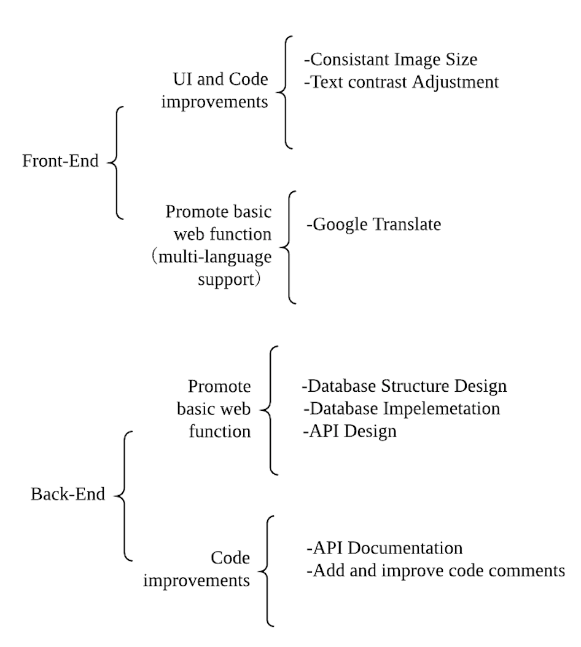
Introduction
Developing a prototype multi-language function supported guide Website with several example exhibitions.
Project outputs.
Front-End
Back-End
Desicion-making, Teamwork, communication.
Reflections.
Notes:
演讲的时候注意重点和时间分配！！！

Slide 3
Week 2-3 | Requirements discovery
Week 4-5 | Optimize existing system (Code Refactoring) and add searching functions
Week 6-7 | Build a prototype guide for National Captial Exhbition
Week 8-9 | Improve the both visitor and admin system, add new functions
Week 10-11 | Multi-language support
Week 12 | Test, debug & pass onto clients

Slide 4
Schedule changed.
Show Trello
Week 2-3 | Requirements discovery
Week 4 | Optimize existing system (Code Refactoring, new database setting)
Week 5-7 | Build a prototype Multi-language function supported guide Website with several example exhibitions from the National Capital Exhibition.
Week 8-11 | Improve the both visitor and admin system, add new functions
Week 12 | Test, debug & pass onto clients
Notes:
Schedule changed.

Slide 5
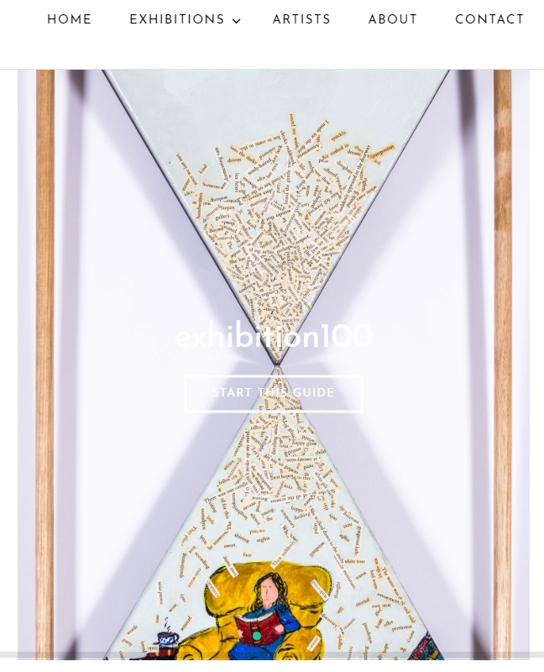
Front-End: UI
Text Contrast Adjustment
The Problem:
Text is hard to read sometimes
The Descision:
Two solutions to make the text readable
Issue In Teamwork:
Duplicate work (Kind of)
Notes:
Yuanze Niu
Change contrast on homepage exhibitions’ title

Slide 6
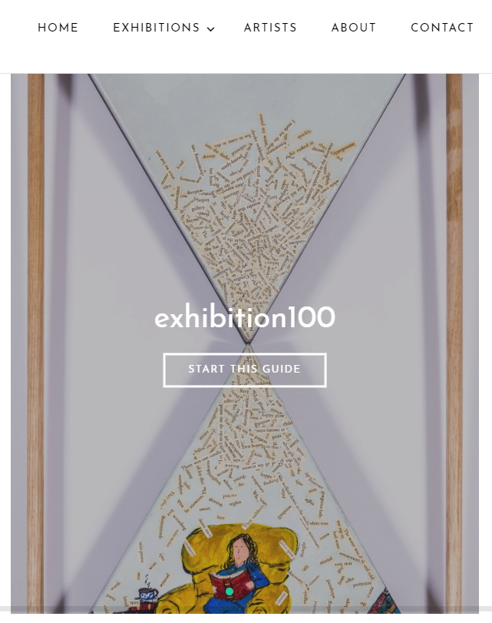
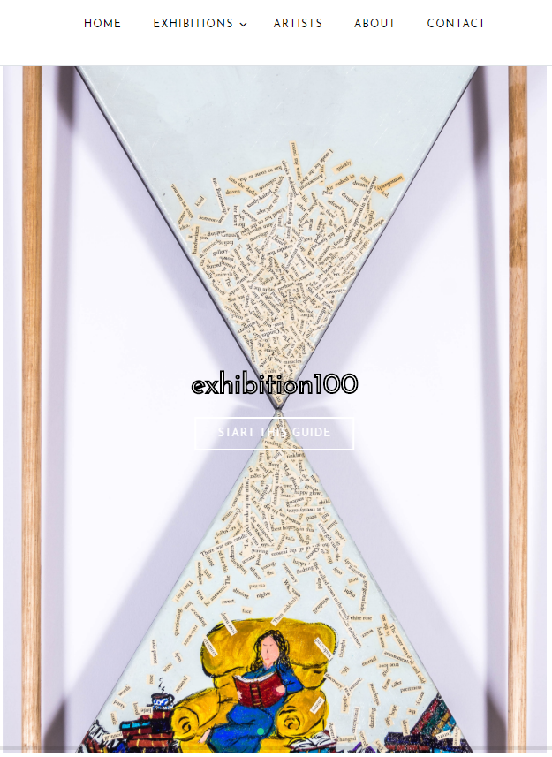
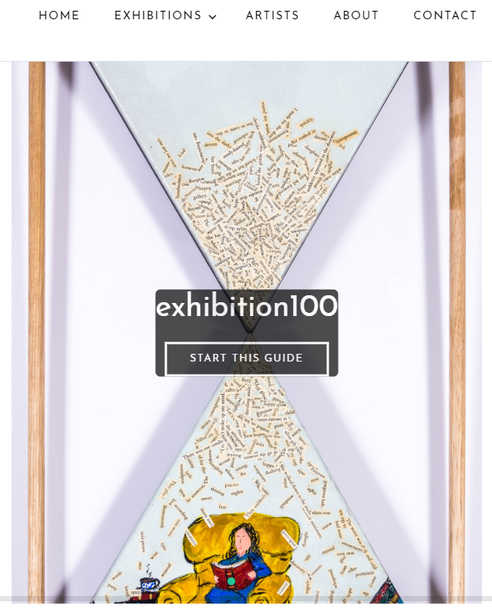
Front-End: UI
Text Contrast Adjustment
Communication:
Discussed if there is any better
solution
Show the different solutions to clients
Reflection:
Clients want a even better design
Still exploring better solution
More communicate before action

Slide 7
More on Front-End
What I did with Front-end team:
Change contrast on homepage exhibition titles
Consistent image size on Exhibition page
Add Google Translate
Decisions I made with the team:
Three plans for this (Image has different width height. How to make them the same? )
Risks:
My Macbook pro is broken
Communication issue lead to duplicate work
Notes:
- The results of the prototype are high quality, and are exceeding the expected testing for the prototypes // // - Client feedback has been elicited quite well to understand which version of the prototype, at a high level, is fit for purpose for the client // // - Recommend more frequent paper prototyping of concept early with clients and customers prior to committing to build and test effort // // - The team are building UI to ‘show’ what work has been done? Suggest that the team keep this lean, and potentially work out alternative ways in which they can illustrate the work that they are doing
Not much project output yet (early days) but I think they’ve grasped what they need to do pretty well. Team should make sure they listen closely to what we are saying our priorities are for this semester.

Slide 8
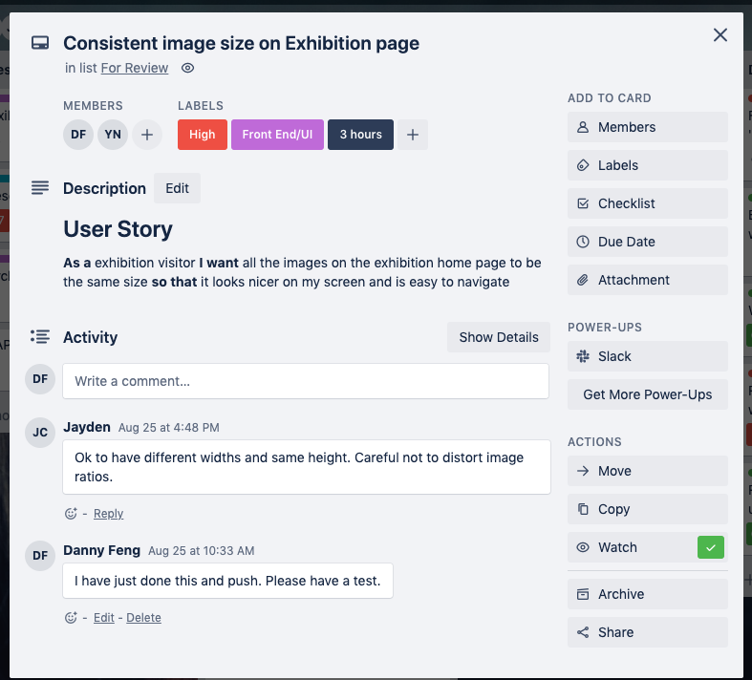
Consistent image size on Exhibition page
As a exhibition visitor I want all the images on the exhibition home page to be the same size so that it looks nicer on my screen and is easy to navigate

Slide 9
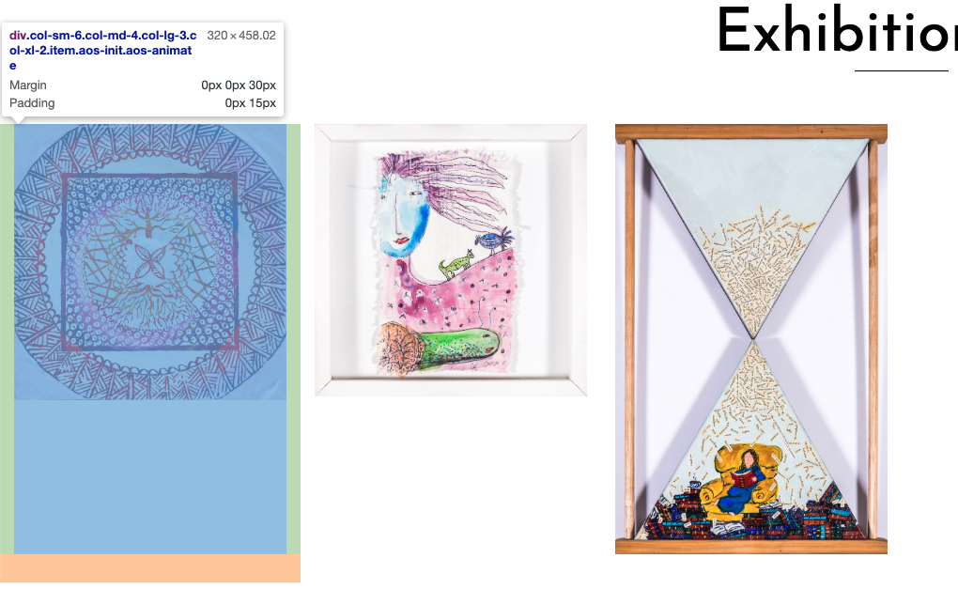
Front-End: UI and Code Improvements
Consistent Image Size on Exhibition Page
Original:
We: Different uploaded image will show as their original size
Client: :(

Slide 10

Front-End: UI and Code Improvements
Consistent Image Size on Exhibition Page
Increment V1:
We: Cut the image when the size is greater than 200px
Client: hmmmm

Slide 11
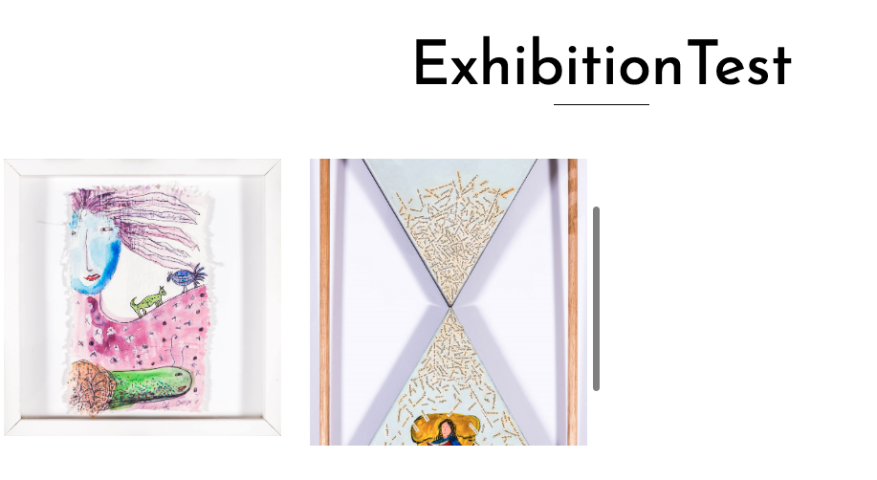
Front-End: UI and Code Improvements
Consistent Image Size on Exhibition Page
Increment V2:
We: Second version. We’ve added a scroll bar!
Client: Hold my bear…..

Slide 12

Front-End: UI and Code Improvements
Consistent Image Size on Exhibition Page
Increment V3:
We: Limit the height. Scale accordingly and keed the ratio.
Client: We are satified with this :)

Slide 13
Front-End: UI and Code Improvements
Consistent Image Size on Exhibition Page
Discussed with the team and clients and we finally made decision to use the last one.
But this long exploring proceess is a waste of time.
Reflection:
We didn’t confirm with client how they want this to be done
We need to bring serveral detail plan to them choose next time
Not familiar with the issue until looking to it - Commincation!

Slide 14
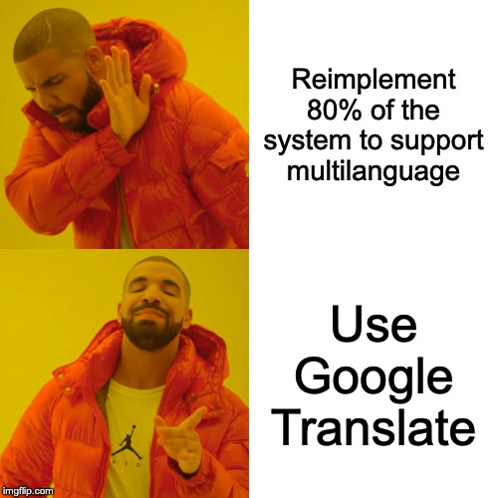

Slide 15
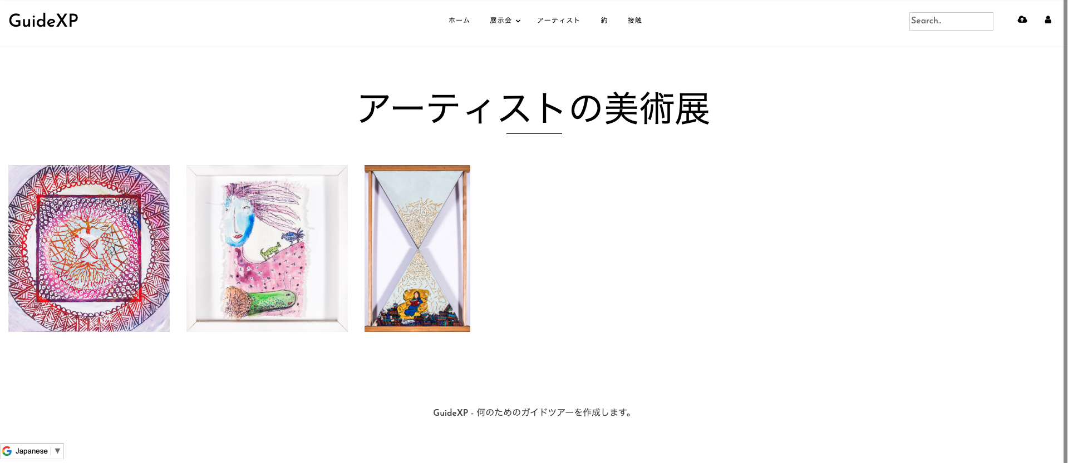
Front-End: Promote Basic Web Function
BIG Task: Multi-languages for all contents
We temporary use Google Translate for requairment confirmation

Slide 16
Back-End
Promote Basic Web Function
API Design
Database Design
Database Implementation
In order to:
Multi-language support
Improve upload flexibility
Enable live search
Code Improvements:
Add and improve code comments
Notes:
Promote Basic Web Function
-multi-language support
-upload order
-search
Code improvements:
-Add and improve code comments

Slide 17
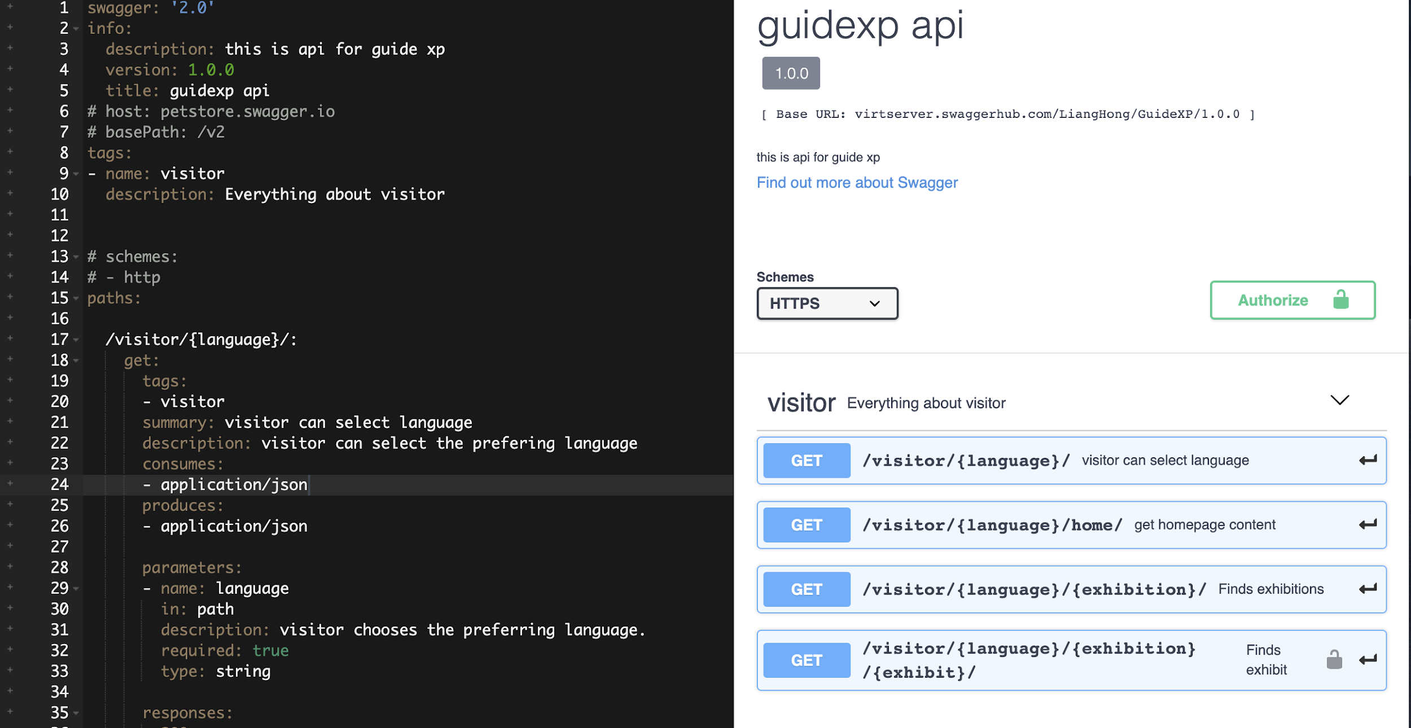


Back-End: Promote Basic Web Function
API Design

Slide 18
Back-End: Promote Basic Web Function
Database Design & Implementation:
Multi-language Support
Improve Upload Flexibility
Enable Live Search
Notes:
multi-language: communicate with clients, by considering their advices and suggestions, modify and revise, confirm a final version: 1) maintain the original structure 2) ease to manage translation records
upload and search: new table? new attributes? new data type? l
json text

Slide 19
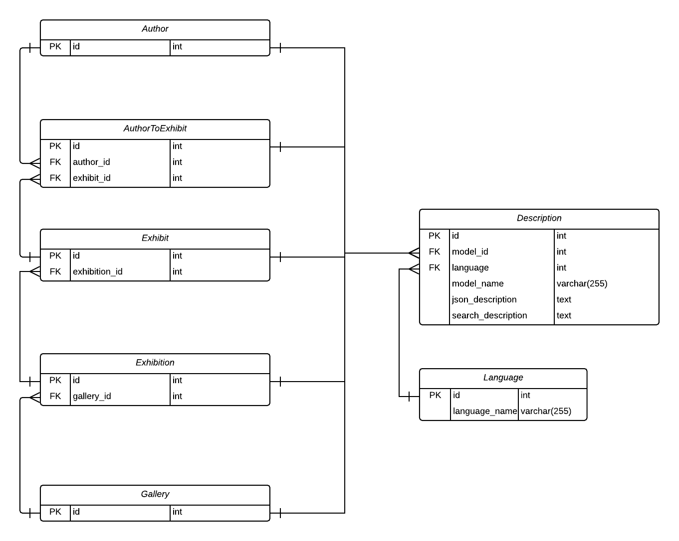
Back-End: Promote Basic Web Function
Notes:
multi-language: communicate with clients, by considering their advices and suggestions, modify and revise, confirm a final version: 1) maintain the original structure 2) ease to manage translation records
upload and search: new table? new attributes? new data type? l
json text

Slide 20
Back-End: Code improvements
Add and Improve Code Comments
Exsiting API Documentation
For inner team and any new members
For stakeholders including clients

Slide 21
Reflection-- prepare for the next stage
Reflections of the AP1’s?
-- Feedbacks analyses.
Weekly / sprint planning, tasks achieved, project is in good process.
-- Tasks assignment, cooperations of front-end team and back-end team.
-- Every meeting, everyone states what they worked on last week.
-- Remember our current process, to get useful suggestions from client and tutor.
Issue: Already worked very well. However, still some tasks delayed, some tasks had not achieved clients’ requirements.
Main reason: lack of communication
Notes:
- Actioned feedback from previous lecturer and tutors to get more specificity in the deliverables // // - Suggest making this part of weekly / sprint planning, and also do retrospectives better to action feedback
Reflection is good, but I think they need to have more open discussion about how they are using the process and work through anything they think isn’t working. So far much of the reflection has been focused on the product, I think they also need to reflect on their personal working styles and how they can work better together.

Slide 22
Feedback Analyses:
More detailed information delivery of several sections.
Communications: Not the communication approach, the communications which is relative to the project process.(improvement in presentation delivery)
Teamwork: More detaliled informations beyond just meetings.
Focus on how can we show the difference between the two APs.
Output: Decisions/schedule changes. (Maximise actioning of insights)
Presentation performance, based on assessments, the same contents appear in different sections, not wise to conclude in one sections:
Presentation form change, based on contents sections.(Will it be clear for the tutors and examiner?)

Slide 23
Reflection-- prepare for the next stage
Weekly / sprint planning, tasks achieved, project is in good process.
-- Tasks assignment, cooperations of front-end team and back-end team.
-- Every meeting, everyone states what they worked on last week.
-- Remember our current process, to get useful suggestions from client and tutor.
Issue: Already worked very well. However, still some tasks delayed, some tasks had not achieved clients’ requirements.
Main reason: less communication
-- Only delivery tasks on Thursday client meeting, which delay the discussion with our clients of several questions we had met when developing tasks.
-- Have not get latest feedback from our client of the current process.
More tasks delivery on Trello and more communication on Slack, have more client meetings.
Notes:
- Actioned feedback from previous lecturer and tutors to get more specificity in the deliverables // // - Suggest making this part of weekly / sprint planning, and also do retrospectives better to action feedback
Reflection is good, but I think they need to have more open discussion about how they are using the process and work through anything they think isn’t working. So far much of the reflection has been focused on the product, I think they also need to reflect on their personal working styles and how they can work better together.

Slide 24
Thank you!

